Slide 1







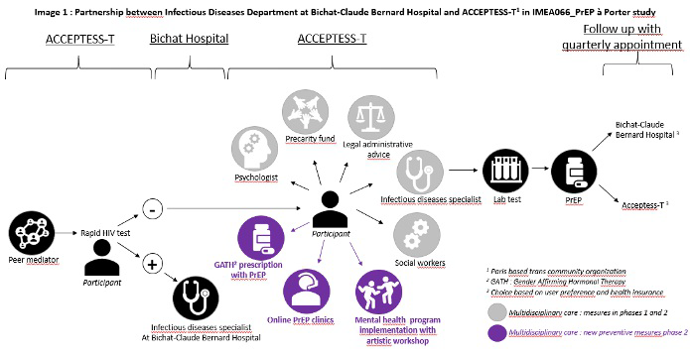



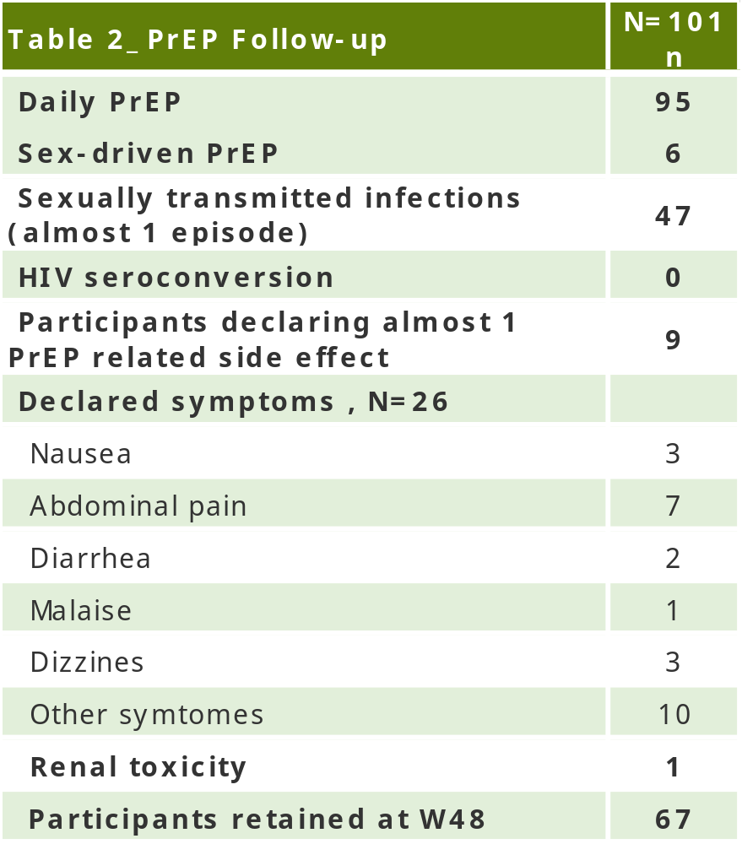
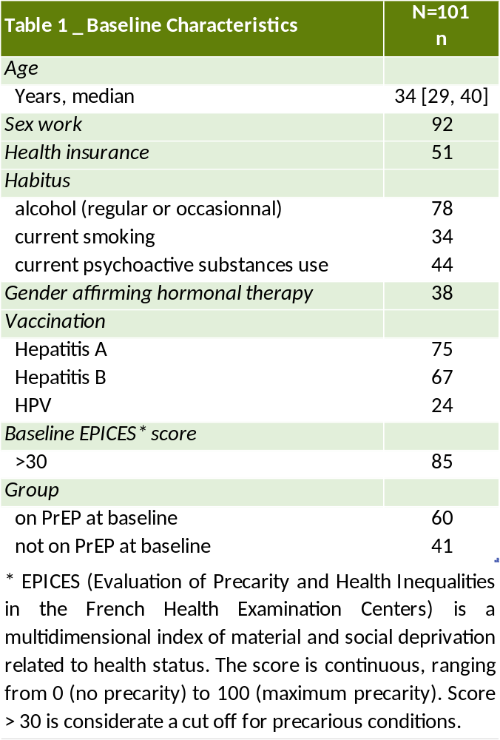



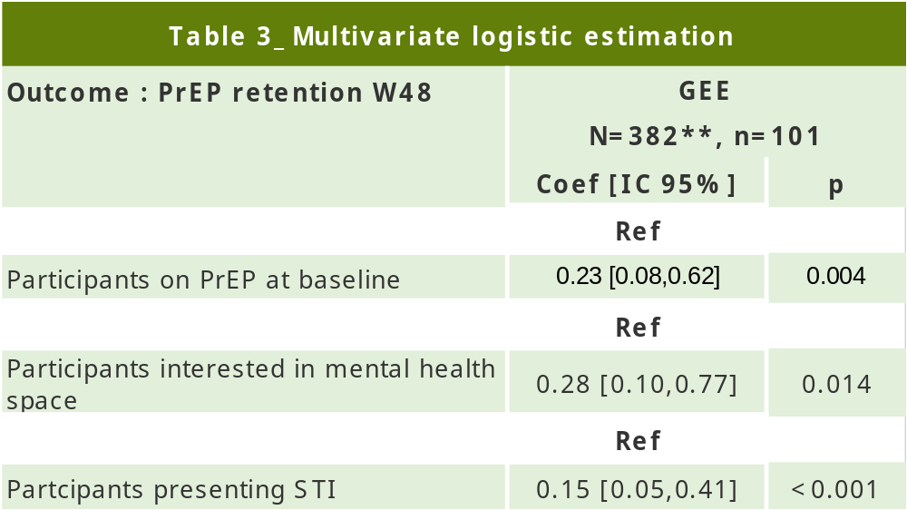
TUPEC175
Key determinants of PrEP persistence in transgender women: first results from the
PrEP à porter study
V. ISERNIA¹ , L. Sagaon-Teyssier² , F. Ouvrard³, A. Faye², F. Peralta⁴ , M. Cervantes¹ , F. Pipitone^{2,5} , G. Girard², A. Deprez¹ , S. Le Gac³ , A. Benalycherif⁶, R.
Landman⁶ , B. Spire² , L. Blanquart⁴, J. Ghosn^{1,7}
1.SMIT, Department of Infectious and Tropical Diseases, Bichat–Claude Bernard Hospital, Paris, France. 2.Aix Marseille Univ, Inserm, IRD, SESSTIM, Economic and Social Sciences of Health & Medical Information Processing, Marseille, France. 3.CoReSS, Regional Coordination for Sexual Health, North‑West
Île‑de‑France, Paris, France. 4. ACCEPTESS-T, Concrete Actions Combining Education, Prevention, Work, Equity, Health, and Sports for Transgender People,
Paris, France. 5.Coalition PLUS Scientific Network, Pantin, France. 6.IMEA, Institute of Applied Medicine and Epidemiology, Paris, France. 7.Université Paris Cité,
INSERM 1137 IAME, Paris, France
Background
Despite the high prevalence of HIV among transgender women (TW), few prevention initiatives have targeted this specific population. Here we describe a cohort of TW followed-up for PrEP via a multidisciplinary reach-out program.
Methods
The ongoing “PrEP à porter” study is a single arm mono-center holistic operational and participatory research cohort of TW.
The study is based on a multidisciplinary hospital–community reach-out program offering oral PrEP alongside additional services .
This program involved (IMAGE 1) peer mediator assessment for social issues, sexual transmitted infections (STI) testing, PrEP clinics provided by a Spanish-speaking physician from Bichat Hospital, mental health space, legal support for transphobia related crimes.
TW participating in the cohort were invited to actively participate in the conceptualization of the service via focus groups (FG) in order to identify PrEP obstacles and to co-create tailored solutions.
Analyses concerned a follow-up of 48 weeks with data collected at each visit.
The outcome of the present study is the retention in the PrEP program (=1) with participants with two missed appointments considered as lost to follow-up (=0).
A Generalized Estimating Equation (GEE) logistic model accounting for repeated measures over time was used to estimate the factors associated with retention.
Results
Analyses were conducted over 101 participants (table 1).
Median age [IQR] was 34[29-40] years, 88% were born in Latin-America, 59% were already on PrEP at inclusion, 50% did not have health insurance, 91% declared practicing sex-work.
Ninty-five participants were on daily PrEP (table 2). Over the study period, at least one episode of intolerance was reported by 9% of TW, gastrointestinal symptoms being the most frequent. Fourty-seven percent of participants experienced at least one STI of cases.
No case of HIV serocoversion was reported.
At week 48, 66% (67/101) of participants were still present in follow-up.
Multivariate GEE logistic estimation (aOR [95%CI]) highlighted that participants already on PrEP at inclusion (aOR=0.23 [0.08-0.62]),those interested by mental health consultations (aOR=0.28 [0.10-0.77]),and those who had at least one STI (aOR=0.15 [0.05-0.41]), were less likely to abandon the follow-up (table 3).
Based on participant demand, new measures were developed and integrated into the ongoing phase 2 study, including gender-affirming therapy prescription, telemedicine PrEP follow-up and enhanced mental health support through artistic workshops (image 1).
** Total number of visits analysed
Conclusions
Preliminary findings suggest that a multidisciplinary, community-based PrEP program can achieve satisfactory retention among transgender female sex workers, a population historically affected by frequent interruptions in care.
Higher retention was observed among:
- participants already receiving PrEP at enrollment, suggesting that socioeconomic vulnerabilities (e.g., lack of legal residency status and health insurance), which are particularly common among newly arrived migrants, may negatively affect retention. These findings highlight the importance of addressing structural vulnerabilities alongside HIV prevention interventions;
- participants with mental health needs and ongoing medical follow-up, particularly for STI management, emphasizing the value of a multidisciplinary, flexible, and user-centered model of care.
Finally, the co-development of new prevention measures in collaboration with participants led to the implementation of an innovative adaptive prevention strategy, which is currently being evaluated.
Valentina.isernia@aphp.fr

